Slide 1
Chapter 6:
The Growing Socioeconomic Gap between Rich and Poor

Slide 2
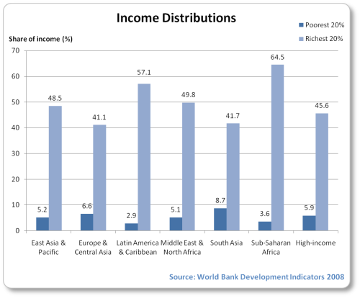
Notes:
Wikipedia

Slide 3
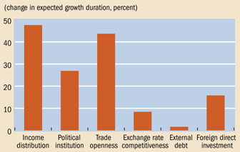
Notes:
Wikipedia

Slide 4
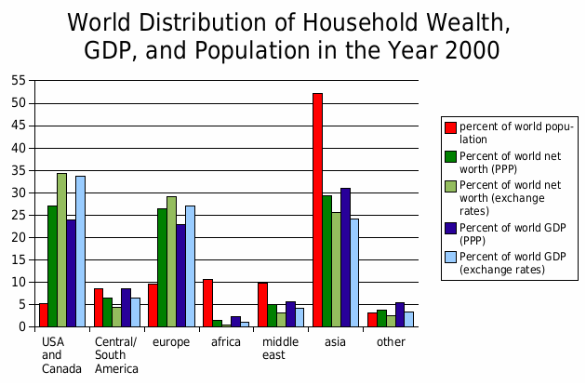
Notes:
Wikipedia

Slide 5
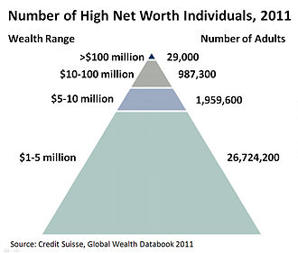
The World’s Elite Class
Notes:
Number of high-net-worth individuals in the world, 2011. Wikipedia

Slide 6
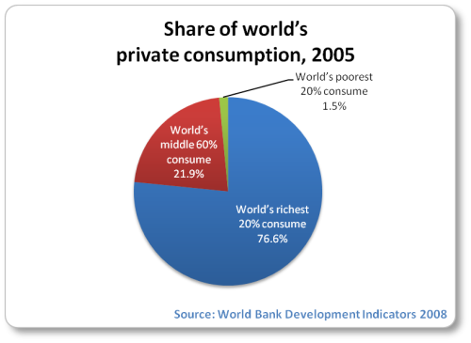

Slide 7
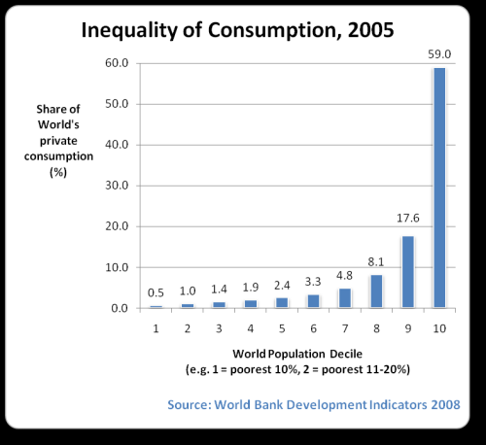
Notes:
Wikipedia

Slide 8
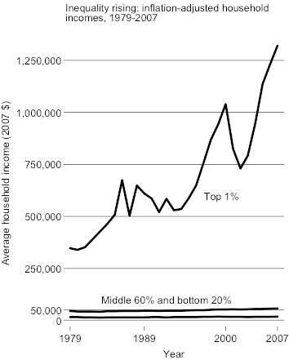
Notes:
Graph shows changes in real US incomes in top 1%, middle 60%, and bottom 20% from 1979 -2007. Wikipedia.

Slide 9
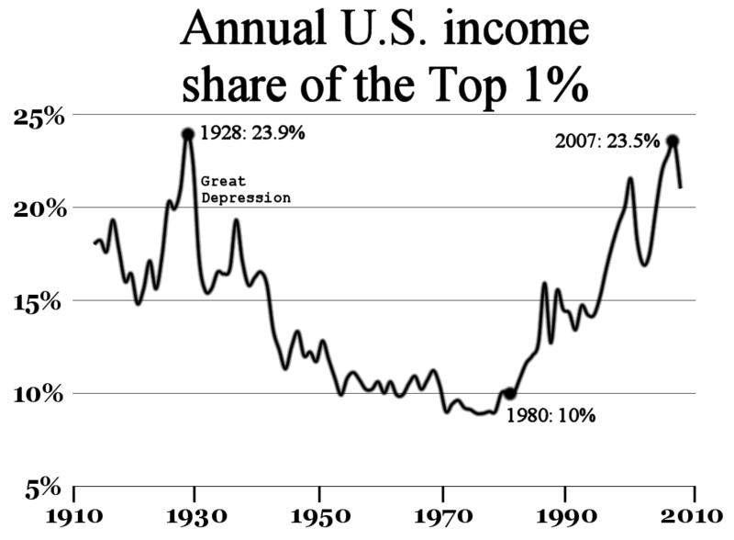
Notes:
Wikipedia

Slide 10
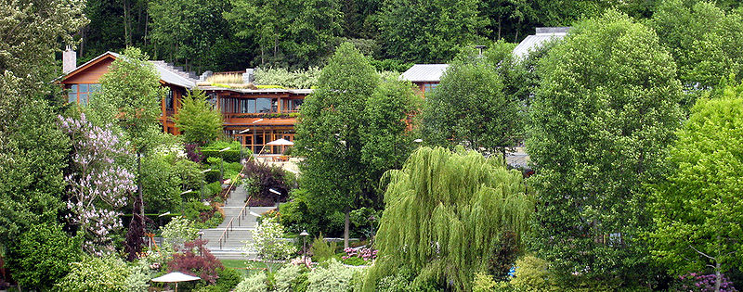
Elite Class: Bill Gates Home
Notes:
Bill Gates home on the shores of Lake Washington, Seattle, Washington, USA. Wikipedia

Slide 11
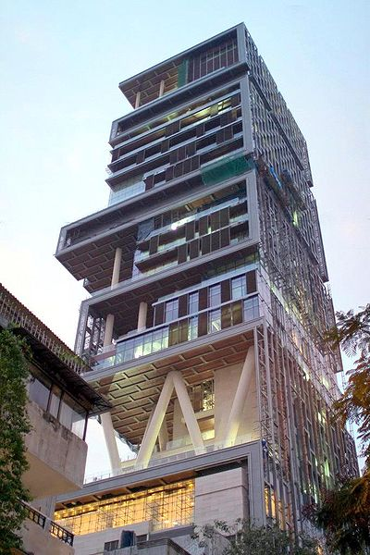
World’s Elites, Home of Mukesh Ambani, Mumbai , India
Notes:
Wikipedia

Slide 12
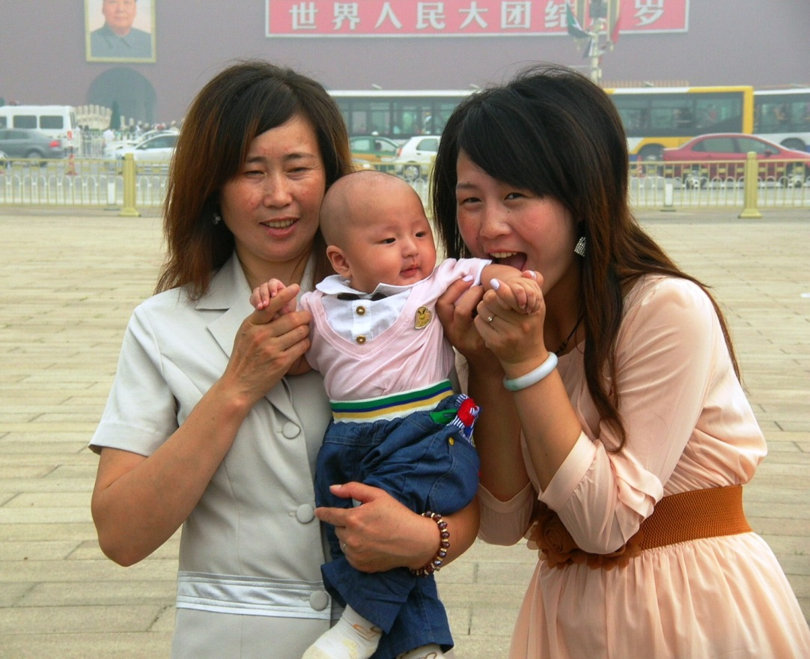
The World’s Middle Class
Notes:
Chinese middle class family, photo Denise Ames

Slide 13
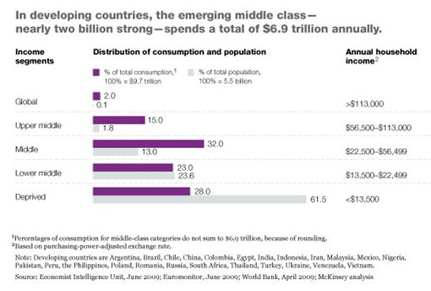
Notes:
Wikipedia

Slide 14
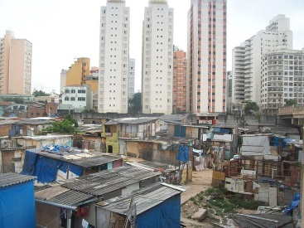
The World’s Poor
Notes:
Wikipedia

Slide 15
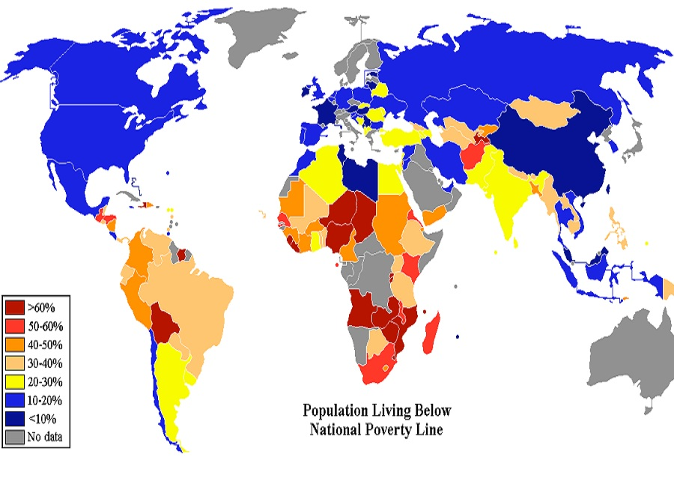
Notes:
Do not reproduce, for PP use only.

Slide 16
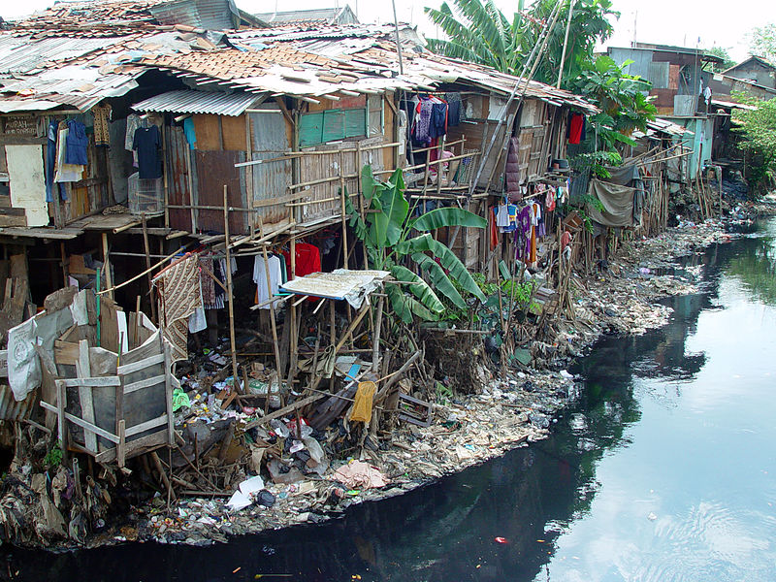
Notes:
Urban poor in this slum in Jakarta, Indonesia. Wikipedia

Slide 17
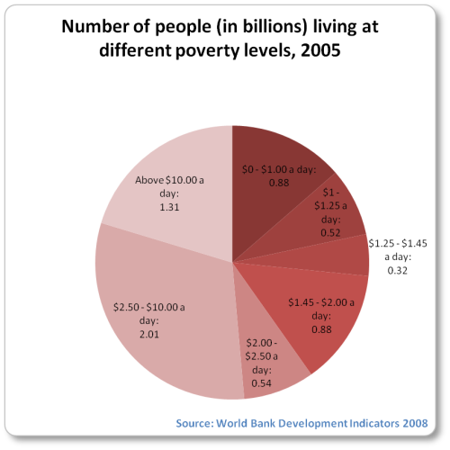
Notes:
Wikipedia

Slide 18
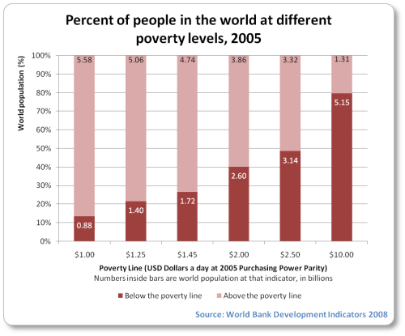
Notes:
Wikipedia

Slide 19
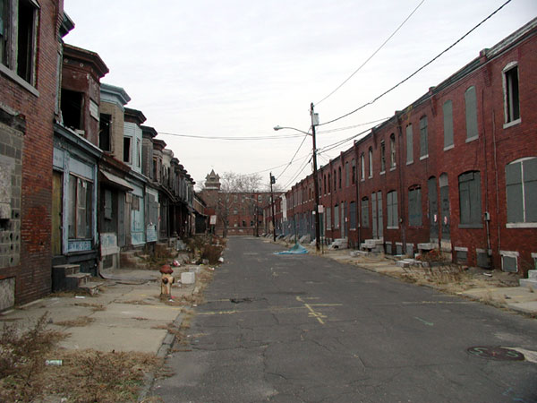
Poverty in the United States
Notes:
Camden, New Jersey is one of the poorest cities in the United States. Camden suffers from unemployment, urban decay, poverty, and many other social issues. Much of the city of Camden, New Jersey suffers from urban decay. Wikipedia

Slide 20
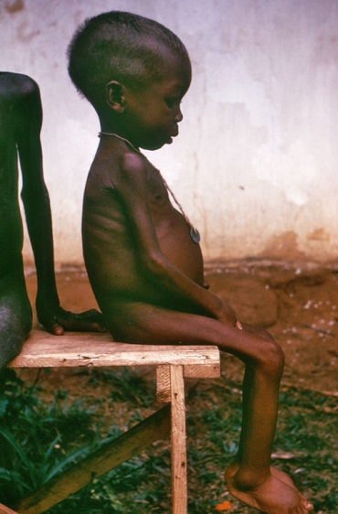
Poverty in Africa
Notes:
Starved girl in Africa

Slide 21
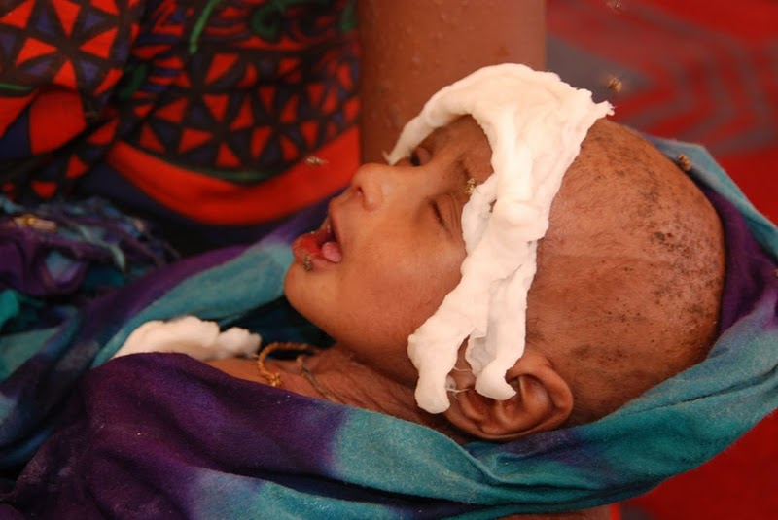
Somali Refugee Camp
Notes:
A Somali boy receiving treatment for malnourishment at a health facility. P. Heinlein - P. Heinlein: Somali Refugees Face Harsh, Uncertain Fate in Ethiopian Camps. VOA News, photo gallery… Wikipedia
A severely malnourished child at Hilaweyn health facility, being held by his mother. VOA - P. Heinlein

Slide 22
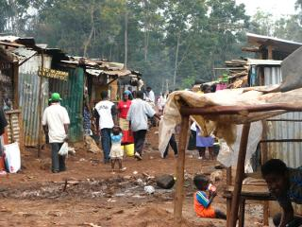
Slum in Nairobi, Kenya
Notes:
Wikipedia

Slide 23
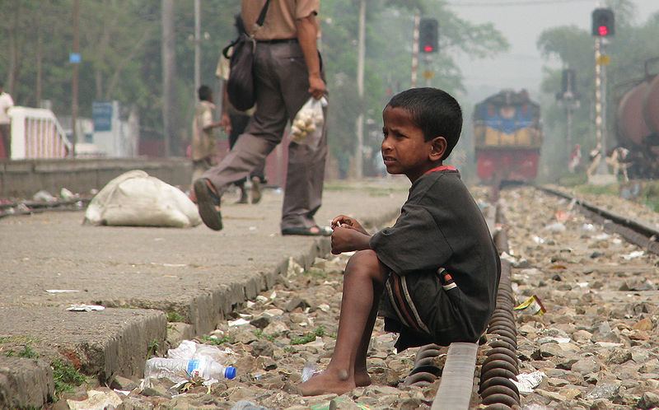
Street Child in Bangla-desh
Notes:
Wikipedia

Slide 24
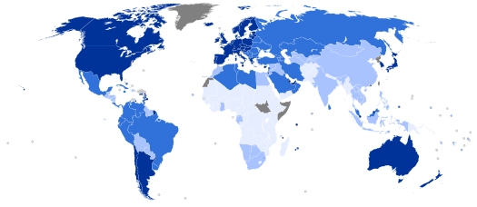
Human Development Report, 2013
Notes:
Dark blue, very high; med. blue, high; light blue, medium; very light blue, low; and gray, no data available. Wikipedia

Slide 25
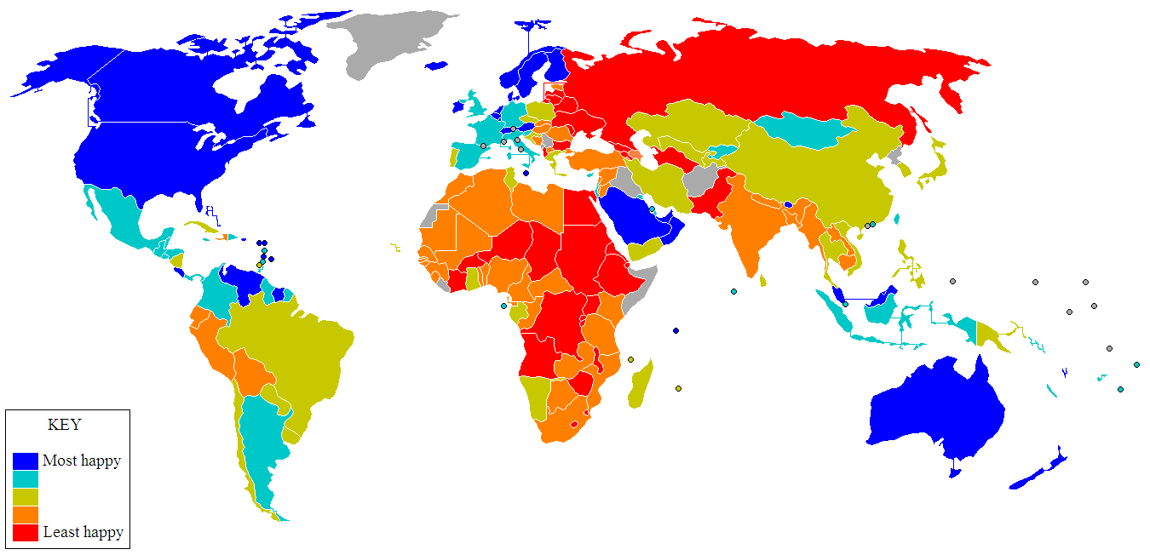
World Happiness Index
Notes:
The Satisfaction with Life Index. Blue through red represent most to least happy respectively; grey areas have no reliable data available. Wikipedia

Slide 26
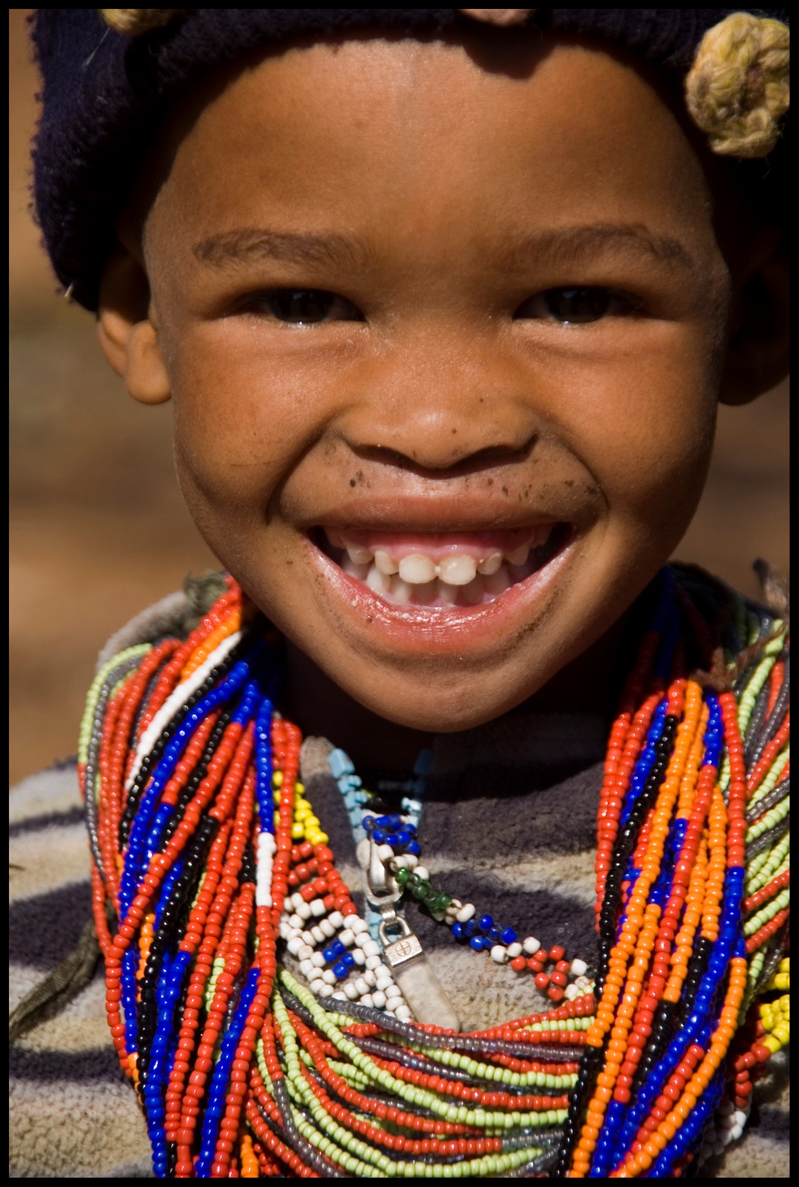
!Kung Girl in Southwest Africa
Notes:
Smiling Girl, !Kung, Bushmen, in Southwest Africa. Photo Isla Bardavid

Slide 27
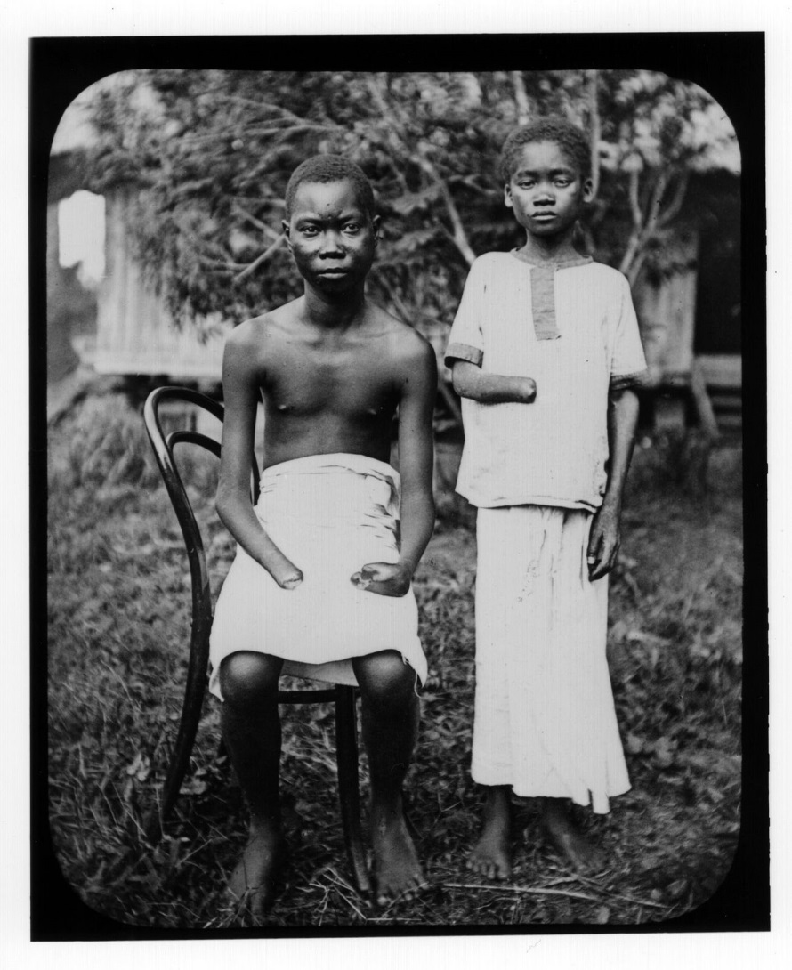
Tragedy of the Congo
Notes:
Wikipedia

Slide 28
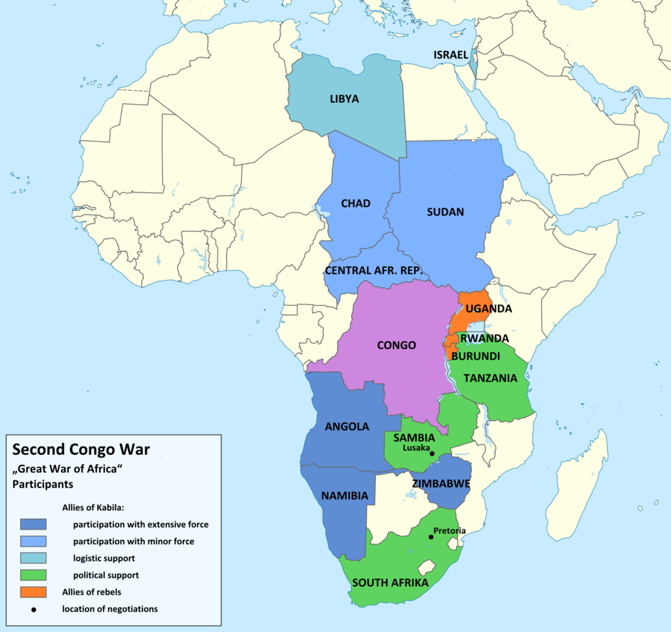
Notes:
Countries participating in the Second Congo War. Wikipedia

Slide 29
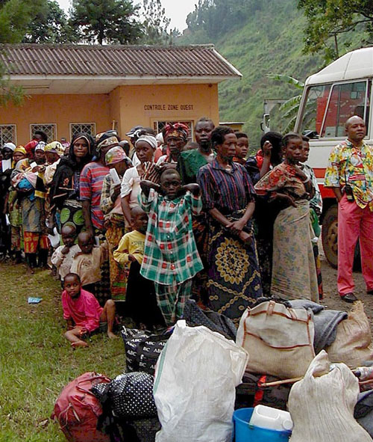
Refugees of the Second Congo War
Notes:
Civilians waiting to cross the DRC-Rwanda border (2001). By 2008 the Second Congo War and its aftermath had killed 5.4 million people. Rape has been used as a weapon of war in both the First Congo War and Second Congo War. Original caption states: "Photo: USAID/Leah Werchick; Rape victims who have been successfully reintegrated into their communities assemble in a “peace hut” near Walungu, South Kivu in DRC.“Wikipedia

Slide 30
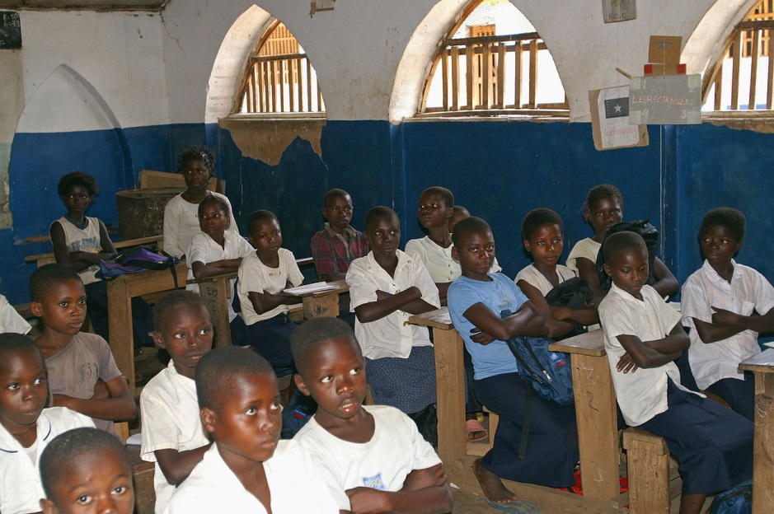
Classroom in DRC
Notes:
Primary school students in a classroom in the Democratic Republic of the Congo, photo, Ken Wiegand (USAID). Wikipedia

Slide 31
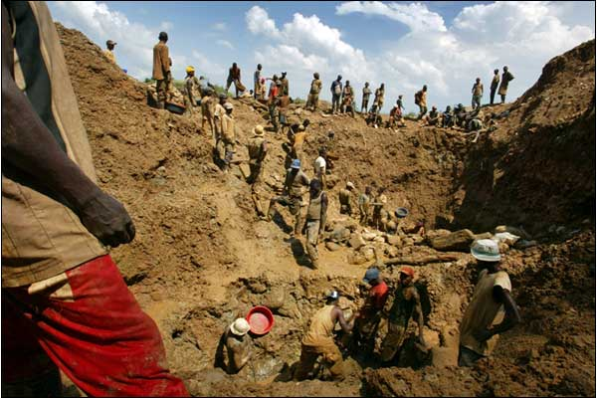
Gold Mining in the Congo
Notes:
Wikipedia

Slide 32
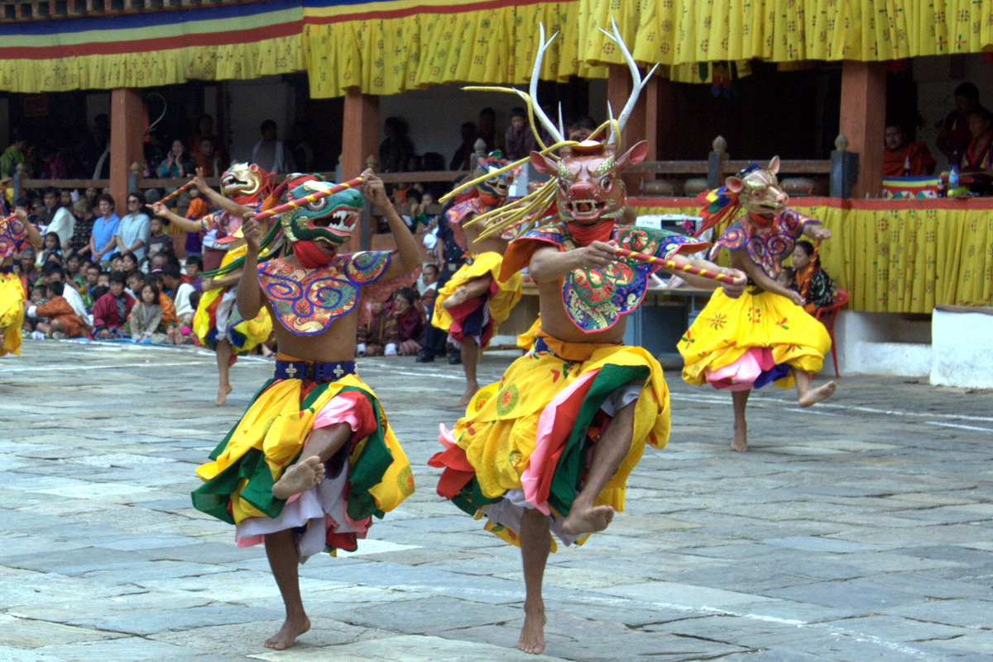
The Hope of Bhutan
Notes:
Teschu dancers at a festival in Bhutan. Photo Roger Harmon

Slide 33
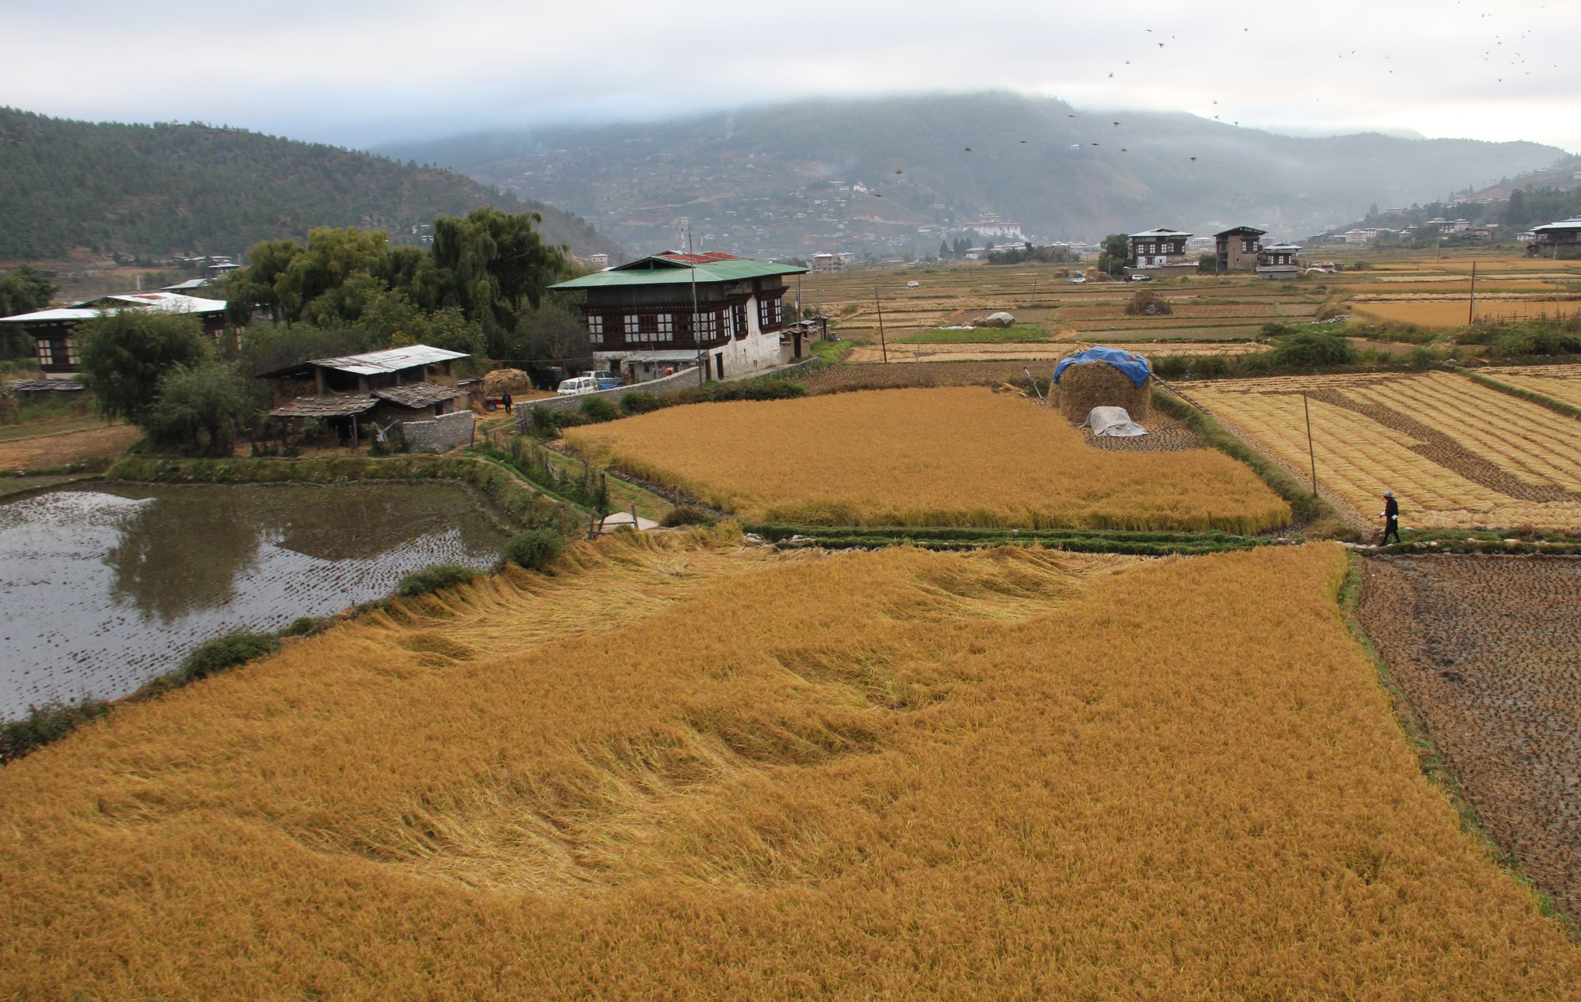
Bhutan Rice Fields
Notes:
Wikipedia

Slide 34
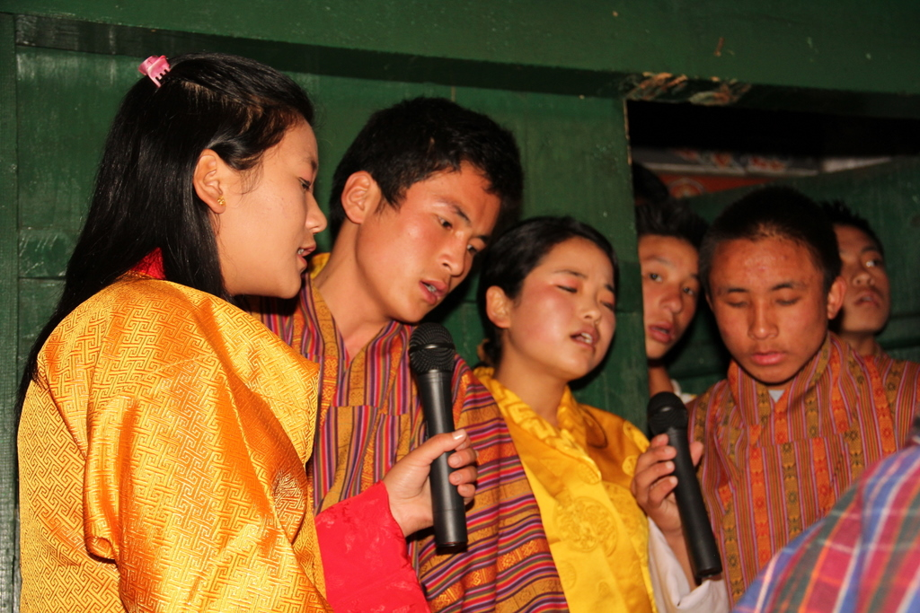
Bhutan Students
Notes:
Bhutan students, photo Roger Harmon

Slide 35
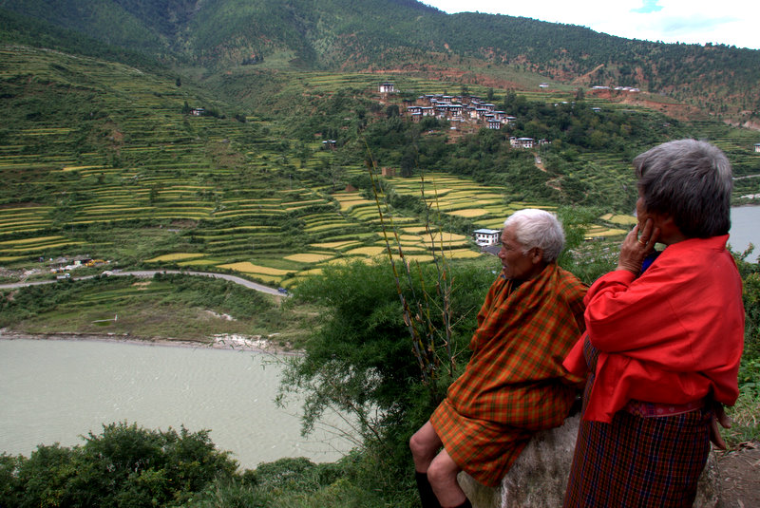
Notes:
Terraced fields in Bhutan, photo Roger Harmon

Slide 36
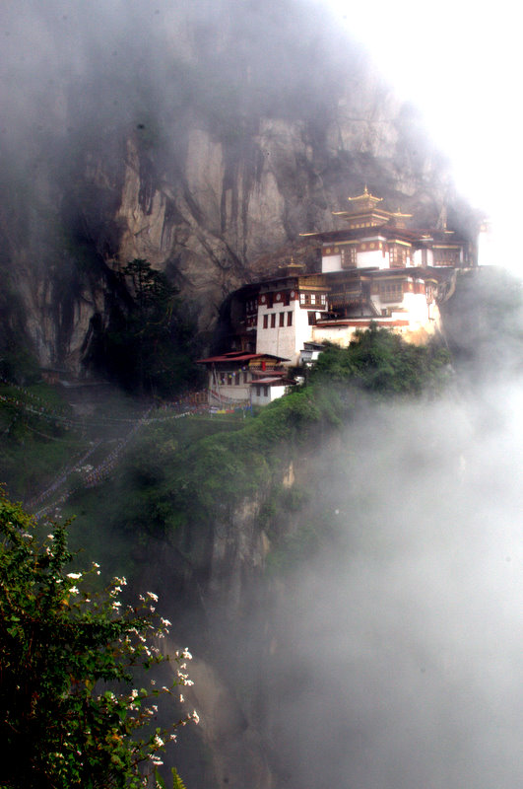
Tiger’s Nest Temple, Bhutan
Notes:
Photo Roger Harmon

